Slide 1
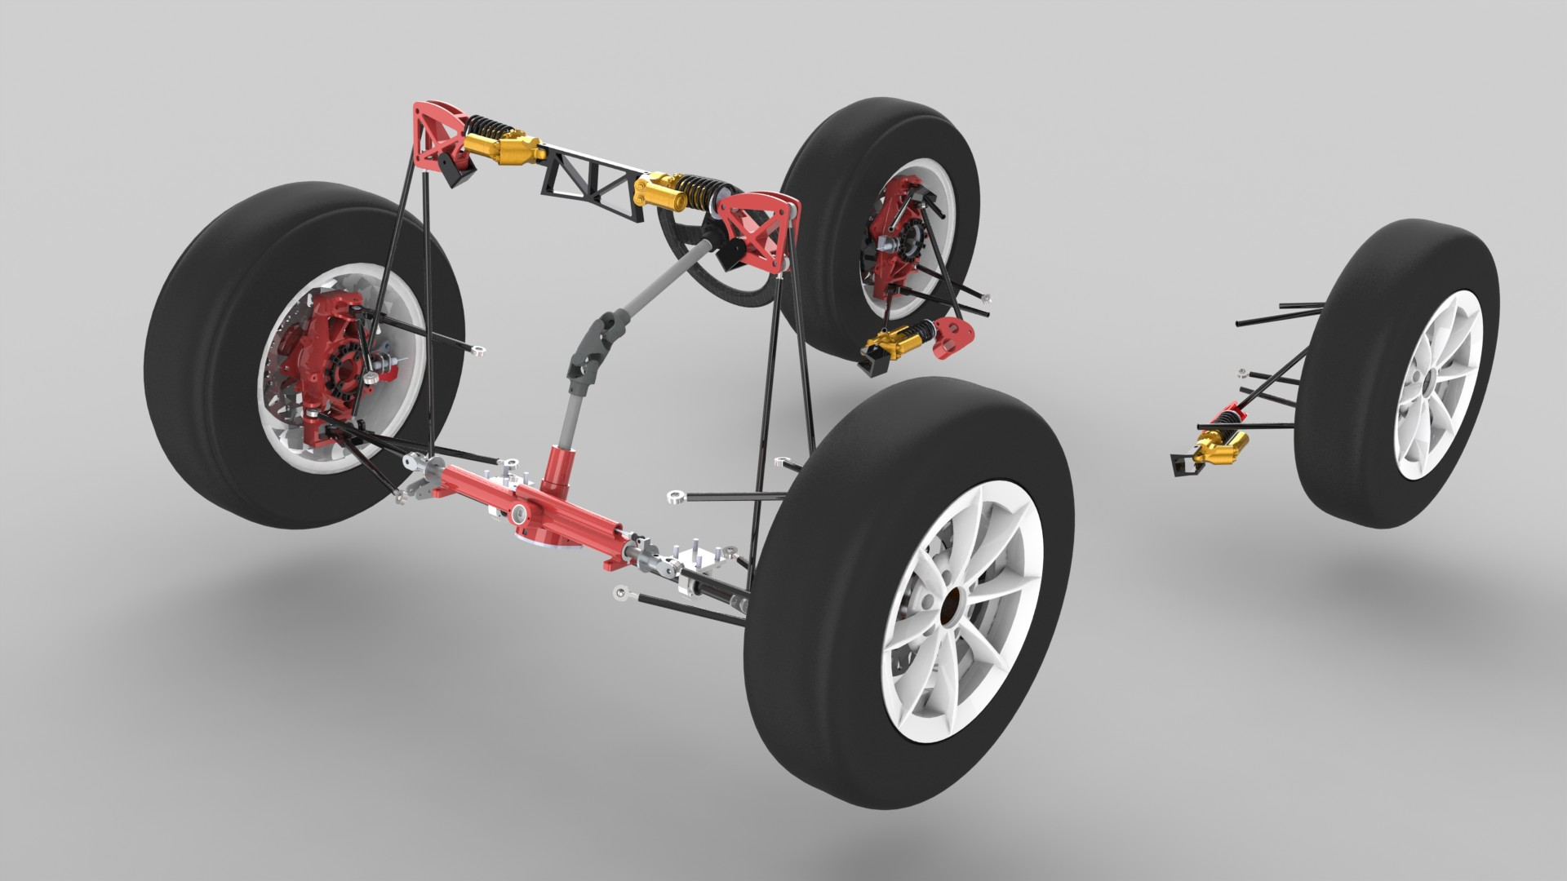
SUSPENSION , STEERING & BRAKES

Slide 2
Need of Suspension
Safety – Road holding capability and stability
Ride Comfort
There is always a trade-off between safety and ride comfort.
Which one would you give a higher priority?
Is there any way to remove the trade-off?

Slide 3
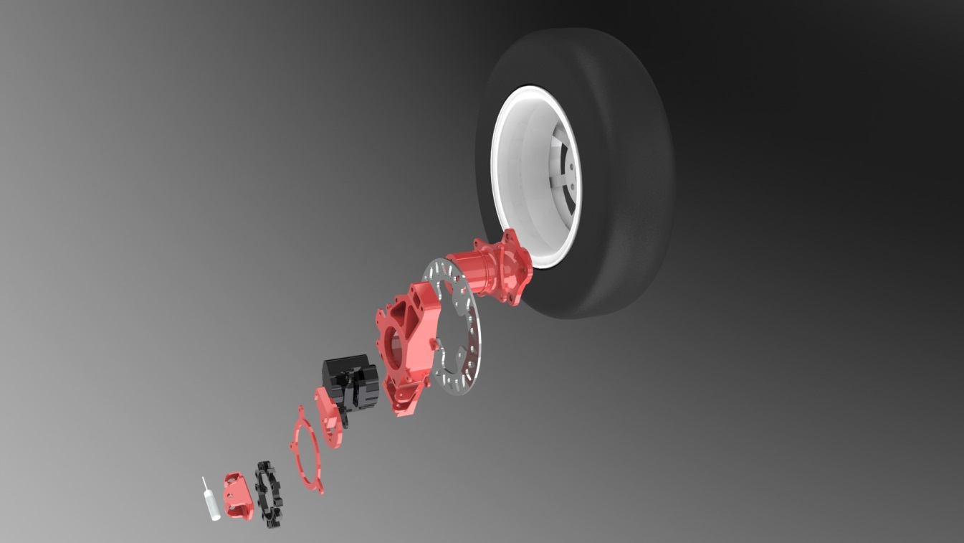
Components of Suspension
Springs (Coil Spring, Leaf Spring, Torsional Bar, etc)
Damper ( Pnematic, Hydraulic, Magnetorheological, etc)
Rocker (Bell Crank)-Reciprocating motion, mechanical advatage
Suspension Linkages
Tire
Rim
Hub
Upright

Slide 4
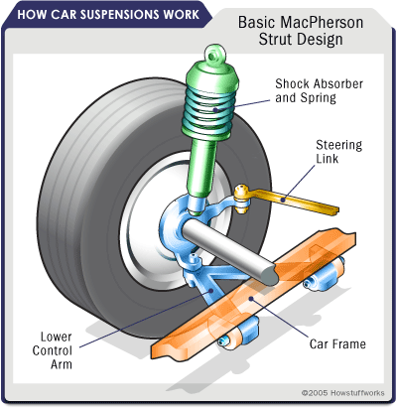
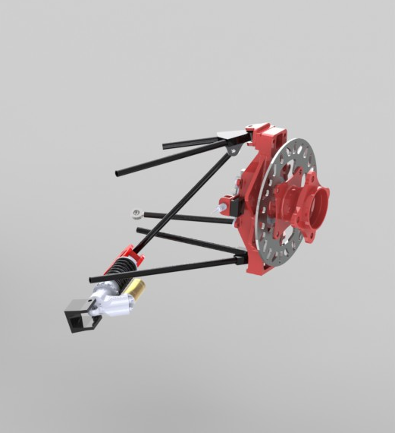
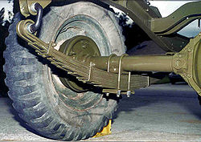
Types of Suspension Geometry
To limit 5 degrees of freedom, 5 links are required.
Mcpherson Strut Geometry (NASCAR cars)
Double Wishbone Geometry (F1 cars)
Leaf Spring Suspension (Trucks)
Each geometry has its own advantage and disadvantage*
* For further reading, surf the internet

Slide 5
Motions of a Car
Straight line motion – Drag Racing
Cornering
Formula Student event involves both straight line motion and cornering motion
Designing the dynamics of a car depends a lot on the track characteristics.
Want an example?
Is Lamborghini fast? Not always! Watch it lose to X1 electric car.
Hell, Lamborghini’s still my favourite car brand!

Slide 6
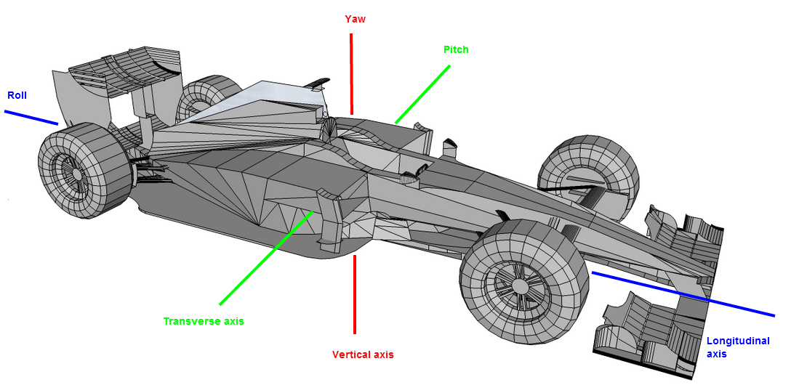
Basic things to control
Roll, Pitch and Yaw (Heave and Rebound for each wheel)

Slide 7
Basic things to control
Traction : How do we control traction?
What do you think is the most basic component of the car which affects traction?
You got that right – TIRES it is!
Of course there are numerous other factors like weight bias, lateral load transfer, longitudinal load transfer, etc.

Slide 8
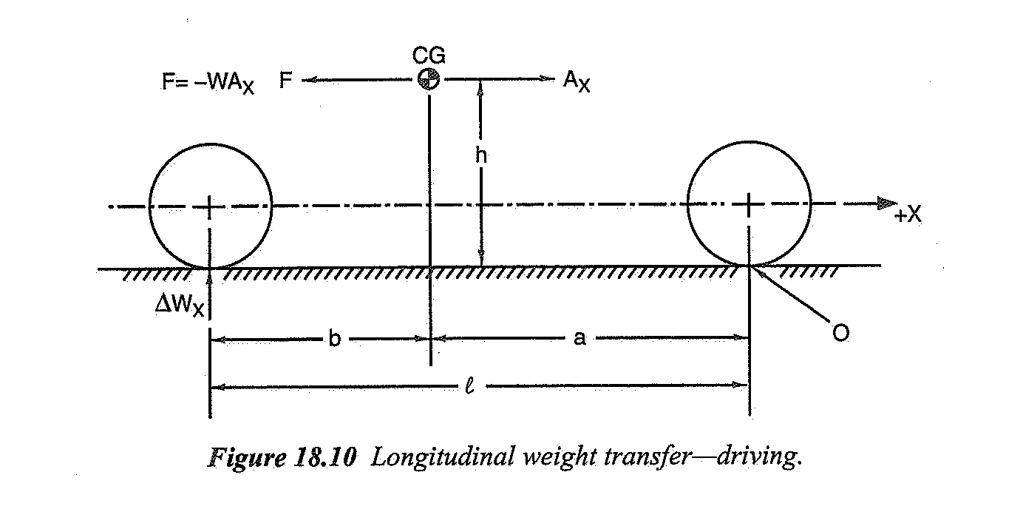
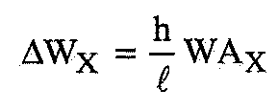
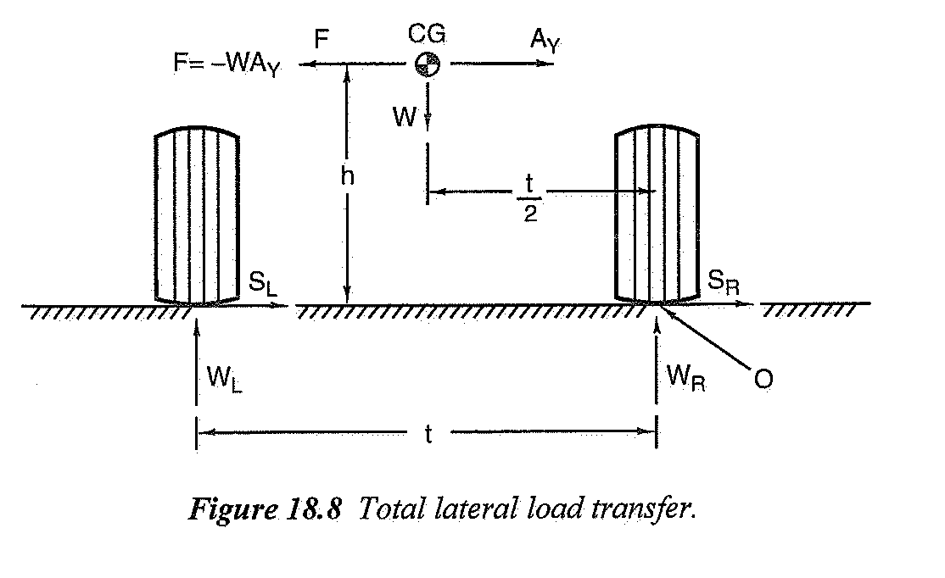
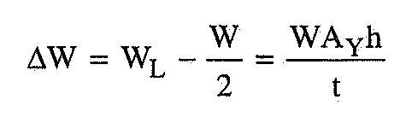
Load Transfer
Determines the load on individual tires which affects traction.
Longitudinal Load Transfer (Acceleration or Braking)
Lateral Load Transfer (Cornering)

Slide 9
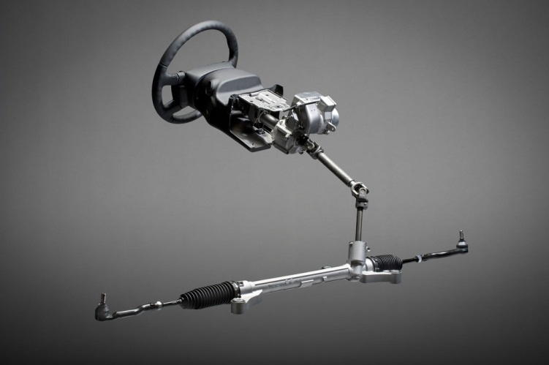
STEERING

Slide 10
Why steering?
To ensure that the wheels are pointing in the desired direction
Reduced driver effort to maneuver bends and turns
Better driver feedback
As always, there is a trade-off between driver effort and feedback
Need to strike the right balance between the two

Slide 11
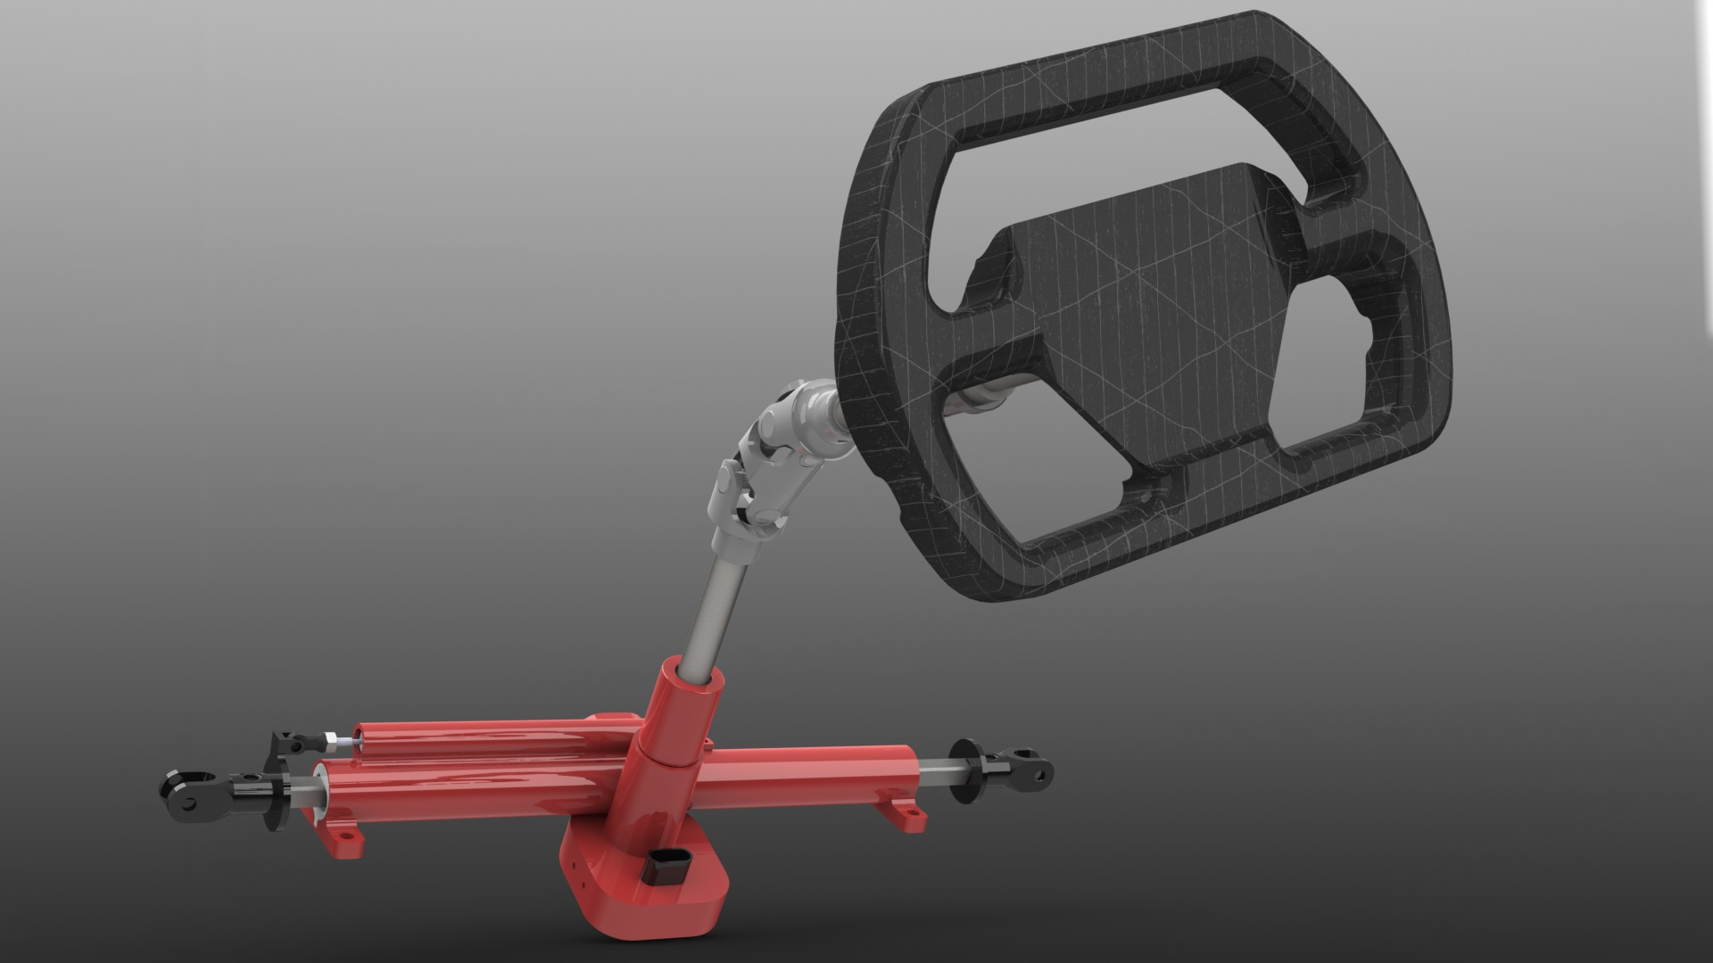
Double UV joint
Steering gearbox
Pinion
Steering wheel
Steering column
Rack
Rack end

Slide 12
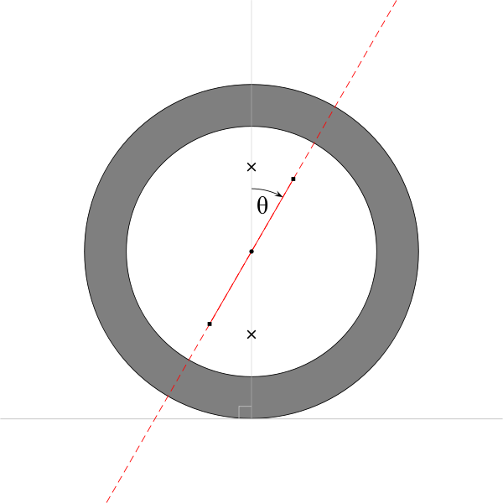
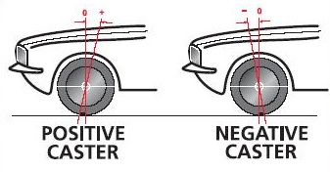
Parameters
Numerous, but three basic are
Caster angle - angular displacement of kingpin axis from the vertical axis in the side view

Slide 13
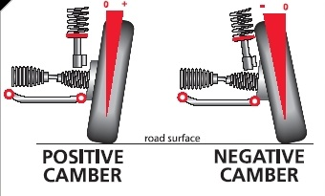
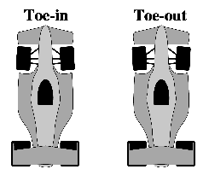
Camber- The angle between the kingpin axis and the vertical axis of the vehicle when viewed from the front or rear
Toe- When a pair of wheels is set so that their leading edges are pointed slightly towards each other, the wheel pair is said to have toe-in.

Slide 14
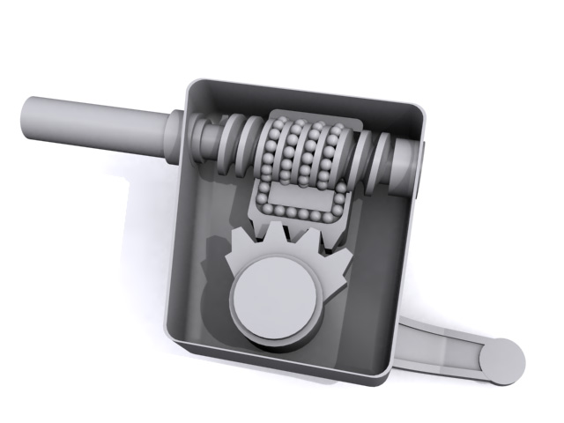
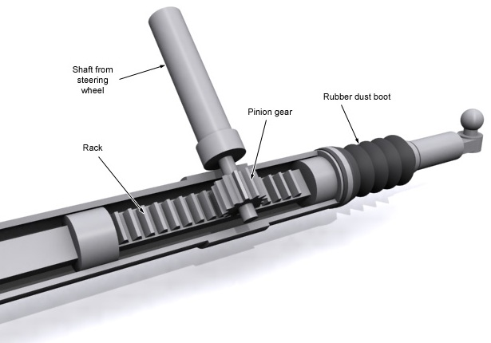
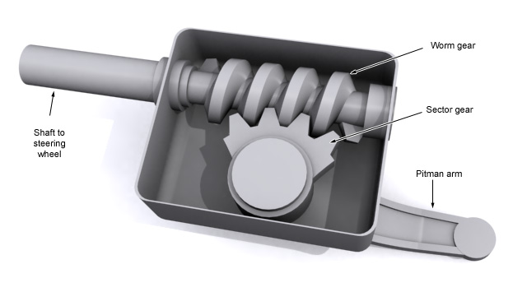
Types of steering
Worm & Sector
Recirculating ball type
Rack & Pinion
Recirculating ball type
Rack & Pinion
Worm & Sector

Slide 15
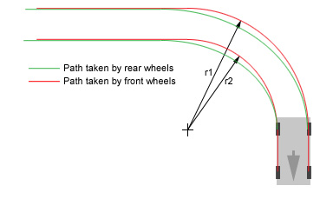
Steering geometry
Both wheels can’t point in the same direction (Why?)
Rear wheels use differential to control speed; front wheels point in different direction – Ackermann geometry
A simple geometry wherein all wheels trace out circles with different radii but common centre.

Slide 16
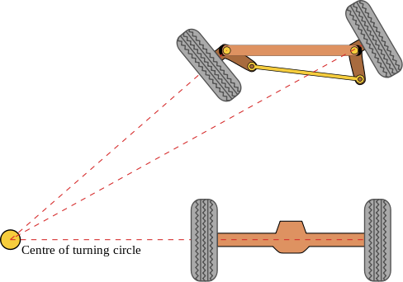
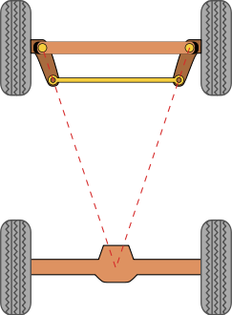
Our car doesn’t use pure Ackermann geometry as it ignores dynamic and compliant effects.
Simplest geometric arrangement for an Ackermann geometry

Slide 17
BRAKES
Main purpose is to stop the motion of a car and bring it to a halt.
Technically, this means the kinetic energy of the car and its moving components should be brought down to zero.
The angular velocity of the tires has to brought down to zero with all four tires locking up simultaneously.
The two basic principles that are utilized in braking mechanism of a car are : 1. Friction 2. Hydraulics
There could be various types of brakes like drum brakes, disc brakes , air brakes. However, the most common and the best effective are the disc brakes.

Slide 18
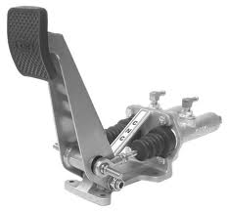
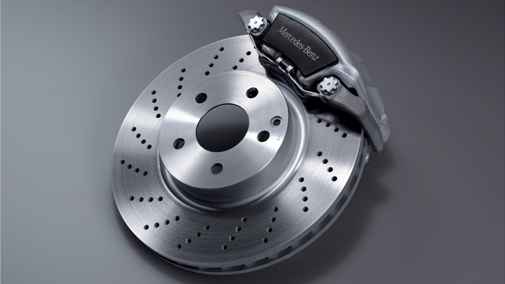
THE MAIN COMPONENTS OF THE DISC BRAKING SYSTEM AND THEIR FUNCTIONS
2. The Hydraulic circuit
1. The Pedal Assembly 3. The Brake Disc and Caliper
FRICTION
It is the friction force acting on the rotating brake disc that brings it to a halt. The pistons push the pads containing the friction material on the brake disc and due to the applied normal force a friction force results which restricts the angular motion.
HYDRAULICS : PASCAL’S LAW
The pressure generated due to the force on the pedal is distributed to the calipers through the brake lines. Manipulating the diameters, the forces can be multiplied as high as ten times the applied force by the driver, and that is how the car is brought to a halt.

Slide 19
Where does the car’s kinetic energy go??
Kinetic energy of the car initially = Heat generated in the disc
½*m*v*v + ½*I*w*w = m*c*T
(for the car) (for the rotation) (for the brake disc)
Remember : This is just an estimate of the rise in temperature !!!!
But how can this friction force, which obviously is a internal force, stop a moving car???
The car definitely has to decelerate due to the external forces acting on it. The frictional force just reduces the angular velocity of the disc and thus the tires. It is actually the frictional force acting on the tires from the road that stops the car. The slowing down of the angular velocity aids this further and locks up the tires.

Slide 20
IMPACTS OF BRAKING ON THE CAR
Due to the large deceleration, there is huge load transfer from the rear to the front. In short, what this means is that the braking force results in redistribution of the car load on the road surface. There is reduced control over steering during heavy braking. In case of severe braking the car can even dive in from the front.
REGENERATIVE BRAKING
In simple words, this means that the motors are rotated in the opposite directions during braking. This means that the motors would get charged up when brake are applied as all the process get exactly reversed. This converts a part of the car’s kinetic energy into the charging of the motors. This system has been utilized in Evo2. This leads to great energy efficiency for battery operated cars.

